Slide 1
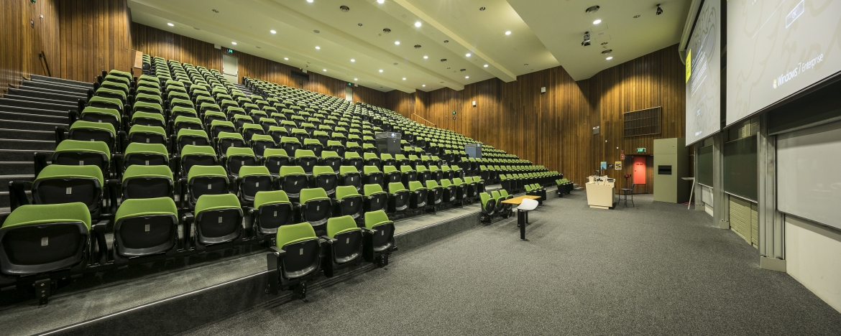
Week 7 Lecture 7.1 Managing Project Execution using Project Controls CASE STUDY
GSOE9820 Engineering Project Management
Term 3 2022
Bernard Hayes

Slide 2
CASE STUDY: UNSW Lecture Theatre Refurbishment / Upgrade
UNSW has taken the opportunity during the COVID crisis to refurbish and update some of its lecture theatres with the latest audio-visual equipment.
1

Slide 3
CASE STUDY: Lecture Theatre Refurbishment / Upgrade
AV Co has won the contract to update the main lecture theatre in the Mechanical Engineering building. The contract was won for $5M which contains a 10% profit margin; and with a 10 month schedule.
You are AV Co’s Project Manager responsible for this project. You have been given an additional 10% project contingency budget before you need to go to back AV Co’s management to seek approval to absorb additional cost.
Current Status: The project is currently at the end of Month 7.
Up until the end of Month 6, the project has been progressing well as seen from the following Earned Value Analysis Report
1

Slide 4
EV Report to End of Month 6
On Budget
On Time
1

Slide 5
Month 7 Progress:
During Month 7, the project hit problems.
At the start of the second week of the month, there was a two week long power outage on the UNSW campus that caused AV Co to stop work, delaying progress whilst still accumulating project costs. Providing power to site was UNSW’s contractual responsibility.
At the end of Month 7, your Accounts Dept. presents you with the following numbers for Month 7:
Earned Value = $80,000
Actual Costs = $200,000
Planned Value = $230,000
1

Slide 6
Earned Value for Month 7 – Question 1:
Have a go giving your answer to this Question via Moodle as a trial for next week.
As a first step, determine which of the following is the correct Course of Action for AV Co to take to optimise its position:
AV Co should seek compensation from UNSW for costs incurred due to the power outage calculated using EV Analysis; plus also seek an “extension of time” on schedule to avoid contract penalties for delays calculated using EV Analysis
AV Co should seek compensation from UNSW for costs incurred due to the power outage calculated using EV Analysis; plus also seek an “extension of time” on schedule to avoid contract penalties for delays calculated using a Tracking Gantt Chart.
AV Co should determine costs incurred due to the power outage calculated using EV Analysis; and if that cost is within the project contingency budget, not claim for extra cost to maintain goods relations with UNSW to facilitate smooth execution of the remainder of the project.
1
Notes:
lo

Slide 7

CASE STUDY: Question 1 - ANSWER
AV Co should seek compensation from UNSW for costs incurred due to the power outage calculated using EV Analysis; plus also seek an “extension of time” on schedule to avoid contract penalties for delays calculated using EV Analysis
Analysis: - Because UNSW is contractually responsible for power supply to the site, AV Co is contractually entitled to compensation and EV Analysis is able to quantify it.
AV Co also has a right to an “extension of time” on the schedule to avoid otherwise applicable penalties for delay. However, EV Analysis is not capable of forecasting schedule performance accurately; and so cannot quantify an “extension of time” claim.
1
Notes:
lo

Slide 8

CASE STUDY: Question 1 - ANSWER
b) AV Co should seek compensation from UNSW for costs incurred due to the power outage calculated using EV Analysis; plus also seek an “extension of time” on schedule to avoid contract penalties for delays calculated using a Tracking Gantt Chart.
Analysis:
As per (a) above, AV Co is contractually entitled to cost competition and EV Analysis is able of quantifying it.
Likewise, AV Co also is contractually entitled to an “extension of time” on the schedule to avoid otherwise applicable penalties for delay; and a Tracking Gantt Chart is able of quantifying it.
1
Notes:
lo

Slide 9
CASE STUDY: Question 1 - ANSWER
c) AV Co should determine costs incurred due to the power outage calculated using EV Analysis; and if that cost is within the project contingency budget, not claim for extra cost to maintain goods relations with UNSW to facilitate smooth execution of the remainder of the project.
ANSWER: Whilst it is always an option for the PM to decide to absorb such a cost in the name of maintaining good relations with a client, especially if it is within the project contingency budget, this needs to be weighted against other considerations, namely:
Absorbing this cost that is clearly UNSW’s responsibility eats into your project contingency budget – meaning less is available for any further unforeseen issues that may be AV Co’s responsibility
Again, absorbing cost does not remove the parallel issue of seeking an ‘extension of time’ for schedule delay to avoid penalties
Notes:
lo

Slide 10
Earned Value for Month 7 – Question 2
Use the results of Earned Value Analysis updated to end of Month 7 to determine what would be the minimum amount of compensation AV Co should seek to bring the project back onto budget :
$ 55,000
$ 80,000
$ 90,000
$202,500.
1
Notes:
lo

Slide 11
CASE STUDY: Question 2 - ANSWER
Contract Value: $5M (Budgeted Revenue)
Profit: 10% ie $500,000 (Budgeted Profit)
Budgeted Revenue – Budgeted Costs = Budgeted Profit
$5,000,000 - Budgeted Costs = $500,000
Therefore, Budgeted Costs (BAC) = $4,500,000
Also:
Project Contingency Budget = 10% of Budgeted Costs(BAC)
= 10% x $4,500,000 = $450,000
1
Notes:
lo

Slide 12
Month 7’s EV Analysis without Compensation from UNSW
BAC = $4,500,000
1

Slide 13
Step 1 – EV Analysis - Adding in Month 7’s EV, AC and PV
$80,000
$200,000
$230,000
1

Slide 14
Month 7’s EV Analysis without Compensation from UNSW
EV (Cumm) = $1,920,000 + $80,000 = $2,000,000
1

Slide 15
Month 7’s EV Analysis without Compensation from UNSW
AC (Cumm) = $1,890,000 + $200,000 = $2,090,000
1

Slide 16
Month 7’s EV Analysis without Compensation from UNSW
PV (Cumm) = $1,825,000 + $230,000 = $2,055,000
1

Slide 17
Month 7’s EV Analysis without Compensation from UNSW
SV = EV – PV = $2,000,000 - $2,055,000 = -$55,000
1

Slide 18
Month 7’s EV Analysis without Compensation from UNSW
CV = EV – AC = $2,000,000 - $2,090,000 = -$90,000
1

Slide 19
Month 7’s EV Analysis without Compensation from UNSW
CPI = EV / AC = $2,000,000 / $2,090,000 = 0.956938
1

Slide 20
Month 7’s EV Analysis without Compensation from UNSW
SPI = EV / PV = $2,000,000 / $2,055,000 = 0.973236
1

Slide 21
Month 7’s EV Analysis without Compensation from UNSW
ETC = (BAC – EV) / CPI = ($4,500,000 - $2,000,000) / 0.96 = $2,612,500
1

Slide 22
Month 7’s EV Analysis without Compensation from UNSW
EAC = AC + ETC = $2,090,000 + $2,612,500 = $4,702,500
1

Slide 23
Month 7’s EV Analysis without Compensation from UNSW
FCVAC = BAC – EAC = $4,500,000 - $4,702,500 = -$202,500

Slide 24
Summary of EV Analysis at End Month 7 What does it tell us about status of project at end Month 7?
 | Cost Variance | Schedule Variance | CPI | SPI | Forecast Variance at Completion
End Month 7 | -$90,000 | -$55,000 | 0.96 | 0.97 | -$202,500
Over Budget
Forecast remain Over Budget
Behind Schedule
Over Budget
Behind Schedule
1

Slide 25
CASE STUDY: Question 2 - ANSWER
Remembering , the minimum compensation would bring CV = 0
So,
CV = EV – AC
$0= ($2,000,000 + X) - $2,090,000
X = Min Compensation Payment = $90,000
Thus, (c ) is the correct answer.
Notes:
lo

Slide 26
CASE STUDY: Question 2 - ANSWER
As a check, show how such a $90,000 payment would be incorporated into Month 7 EV Analysis:
Increase BAC by $90,000 – payment would re-baseline approved budget
Increase EV by $90,000 – payment would be for work in revised budget that has already be undertaken use 100% complete
Leave AC at $200,000 for month – the expenditure has already taken place and been included in the AC figure provided for month
Notes:
lo

Slide 27
Month 7 - Effects of an Additional $90,000 payment from UNSW
Confirms that $90,000 is minimum required payment
CPI = 1.0
BAC and EV Increase by $90,000
FCVAC = $0
1

